Slide 1


Slide 2
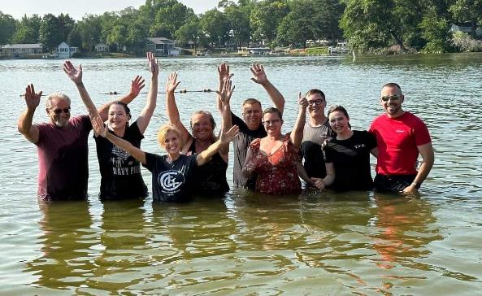
New Baptisms!
Monday, 6 pm
Chandler Park Pardeeville

Slide 3
Our Eyes Are on You
(Jesus)
Faith That Stands When We Don't Know What to Do

Slide 4
⁵ Then Jehoshaphat stood up in the assembly of Judah and Jerusalem at the temple of the Lord in the front of the new courtyard ⁶ and said:
2 Chronicles 20:5-13 NIV

Slide 5
“Lord, the God of our ancestors, are you not the God who is in heaven? You rule over all the kingdoms of the nations.
Power and might are in your hand,
and no one can withstand you.
2 Chronicles 20:5-13 NIV

Slide 6
⁷ Our God, did you not drive out the inhabitants of this land before your people Israel and give it forever to the descendants of Abraham your friend? ⁸ They have lived in it and have built in it a sanctuary for your Name, saying,
2 Chronicles 20:5-13 NIV

Slide 7
⁹ ‘If calamity comes upon us, whether the sword of judgment, or plague or famine, we will stand in your presence before this temple that bears your Name and will cry out to you in our distress, and you will hear us and save us.’
2 Chronicles 20:5-13 NIV

Slide 8
¹⁰ “But now here are men from Ammon, Moab and Mount Seir, whose territory you would not allow Israel to invade when they came from Egypt; so they turned away from them
and did not destroy them.
2 Chronicles 20:5-13 NIV

Slide 9
¹¹ See how they are repaying us by coming to drive us out of the possession you
gave us as an inheritance.
¹² Our God, will you not judge them?
2 Chronicles 20:5-13 NIV

Slide 10
For we have no power to face this vast army that is attacking us.
We do not know what to do,
but our eyes are on you.”
2 Chronicles 20:5-13 NIV

Slide 11
¹³ All the men of Judah,
with their wives and children and little ones, stood there before the Lord.
2 Chronicles 20:5-13 NIV

Slide 12
Eyes on You
Seek God First

Slide 13
³ The Lord was with Jehoshaphat because he followed the ways of his father David before him. He did not consult the Baals
⁴ but sought the God of his father and followed his commands
rather than the practices of Israel.
2 Chronicles 17:3-4 NIV

Slide 14
⁶ His heart was devoted
to the ways of the Lord;
2 Chronicles 17:6 NIV

Slide 15
³ Alarmed,
Jehoshaphat resolved to inquire of the Lord,
and he proclaimed a fast for all Judah.
⁴ The people of Judah came together to seek help from the Lord; indeed, they came from every town in Judah to seek him.
2 Chronicles 20:3-4 NIV

Slide 16
Eyes on You
Trust God Completely

Slide 17
“Lord, the God of our ancestors, are you not the God who is in heaven? You rule over all the kingdoms of the nations.
Power and might are in your hand,
and no one can withstand you.
2 Chronicles 20:6 NIV

Slide 18
⁹ ‘If calamity comes upon us, whether the sword of judgment, or plague or famine,
we will stand in your presence before this temple that bears your Name
and will cry out to you in our distress,
and you will hear us and save us.’
2 Chronicles 20:9 NIV

Slide 19
For we have no power to face this vast army that is attacking us.
We do not know what to do,
but our eyes are on you.
2 Chronicles 20:12 NIV

Slide 20
Eyes on You
Stand Firm Faithfully

Slide 21
“Listen, King Jehoshaphat and all who live in Judah and Jerusalem! This is what the Lord says to you:
‘Do not be afraid or discouraged
because of this vast army.
For the battle is not yours, but God’s.
2 Chronicles 20:15 NIV

Slide 22
¹⁷ You will not have to fight this battle.
Take up your positions; stand firm
and see the deliverance
the Lord will give you,
Judah and Jerusalem. Do not be afraid; do not be discouraged. Go out to face them tomorrow, and the Lord will be with you.
2 Chronicles 20:17 NIV

Slide 23
Jehoshaphat stood and said,
“Listen to me, Judah and people of Jerusalem! Have faith in the Lord your God and you will be upheld;
have faith in his prophets
and you will be successful.
2 Chronicles 20:20 NIV

Slide 24
Jehoshaphat appointed men
to sing to the Lord and to praise him for the splendor of his holiness as
they went out at the head of the army, saying:
“Give thanks to the Lord,
for his love endures forever.”
²² As they began to sing and praise, the Lord set ambushes against the men
of Ammon and Moab and Mount Seir who were invading Judah, and they were defeated.
2 Chronicles 20:21-22 NIV

Slide 25
Conclusion:
God is looking for people who will seek Him, trust Him, and stand firm when they cannot see how He will bring the victory. Jehoshaphat didn't know what to do, but he knew where to look. Let us keep our eyes on Jesus, take our positions of faith and stand firm, trusting our God will fight for us in battle.

Slide 26


Slide 27


